Slide 1


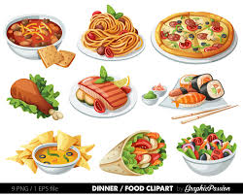

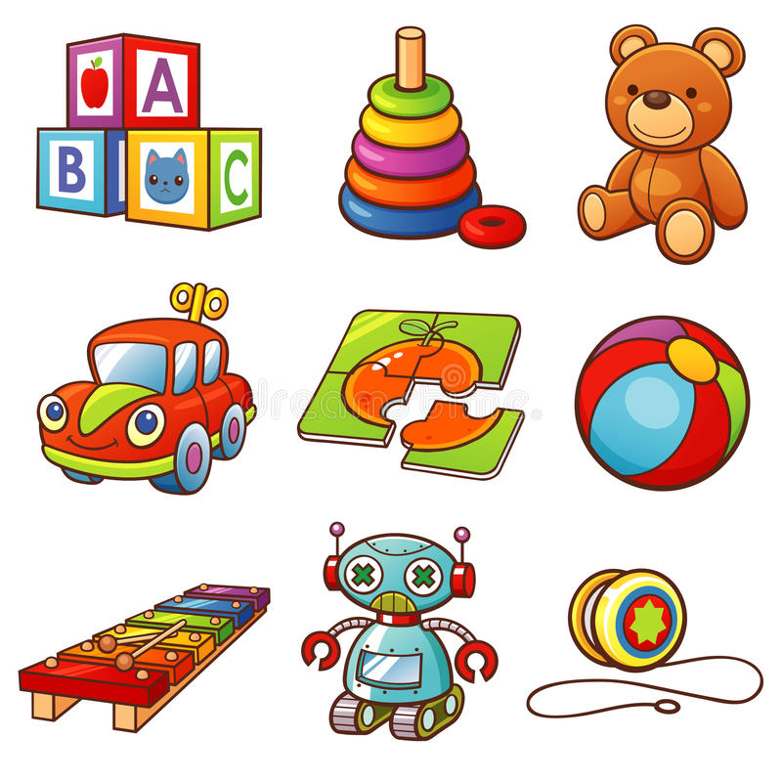

Get to Know You Game!!
Notes:
Have child choose which color blocks to remove and then child and therapist share their favorite: color, tv show or movie, food, toy/game, icecream, super power

Slide 2


Notes:
Virtual Sticker Chart; Fill up the road with stickers and earn ??? Game time at end; reward from caregivers; etc

Slide 3
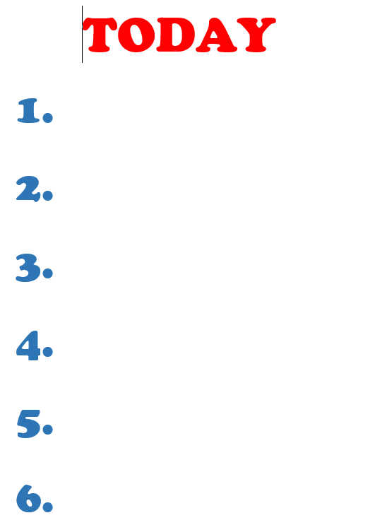
Notes:
Visual agenda to create and check off as you do in session

Slide 4
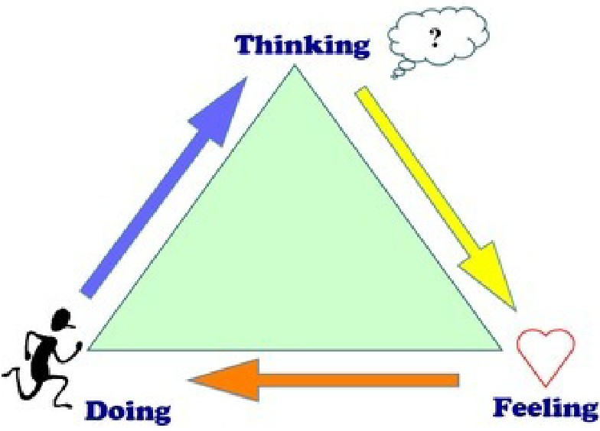


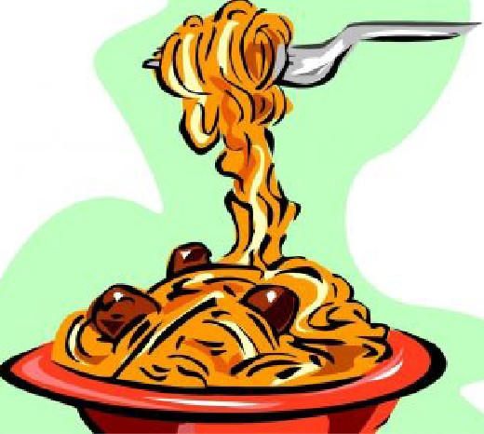
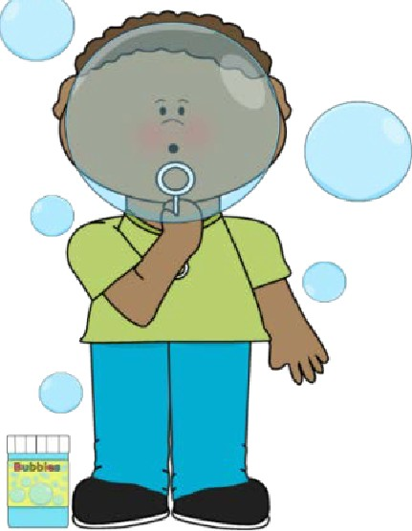
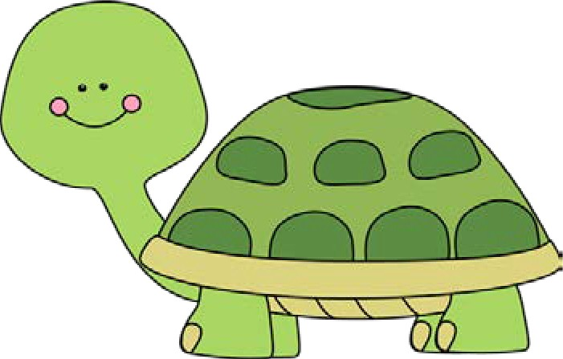


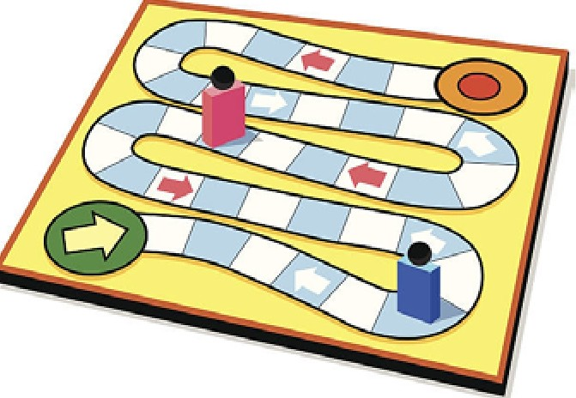

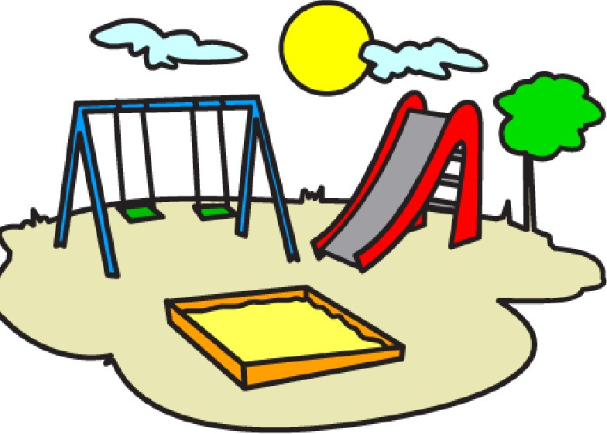

Notes:
For visual agenda

Slide 5
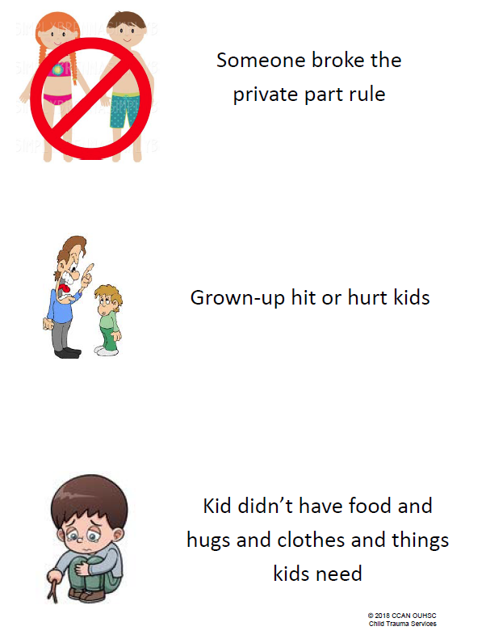
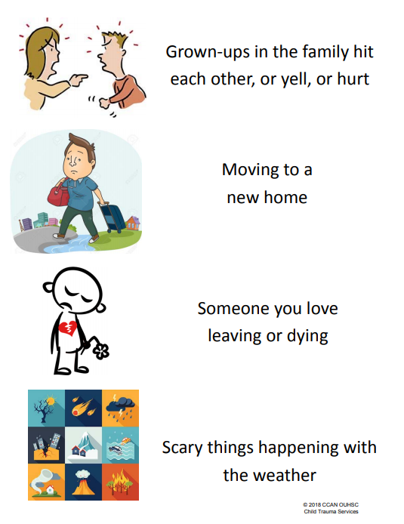
What is trauma?
Notes:
Can use to blue dots for child to identify trauma types they have experienced

Slide 6
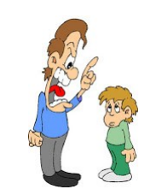
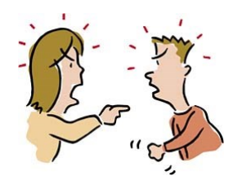

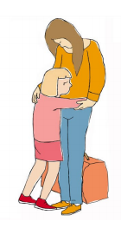
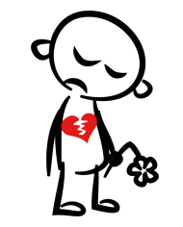

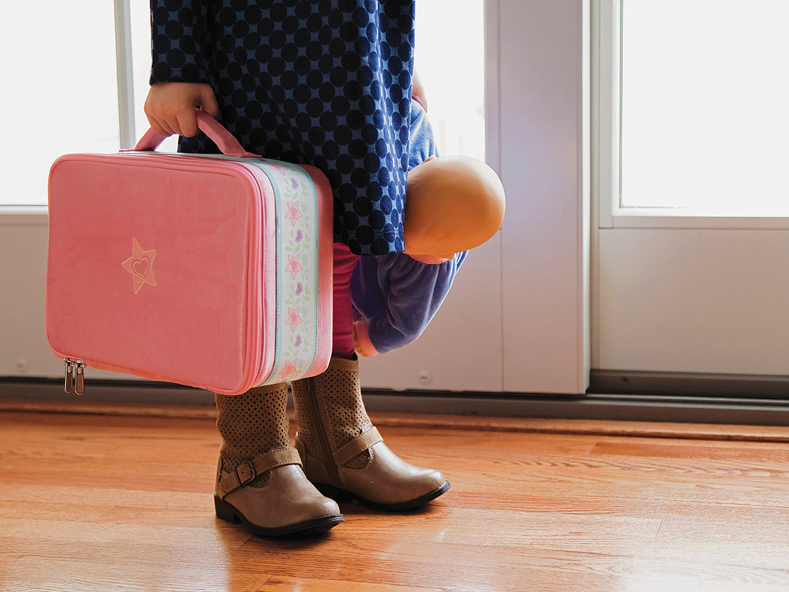
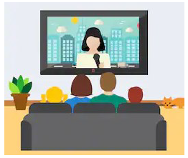
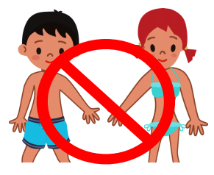
Notes:
Moveable visual images for: physical/verbal abuse; family fighting; neglect; parent leaving; weather related; moving homes; loved one dying; scary things on news; broken private part rule/sexual abuse
Can use throughout other components to include trauma focus (ex: asking feelings when remember trauma)

Slide 7
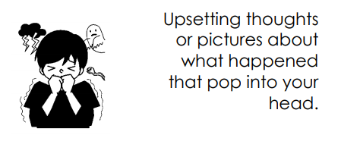
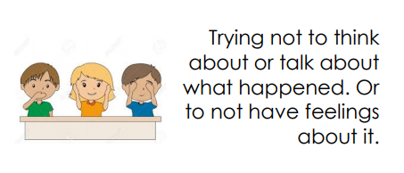
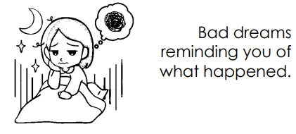
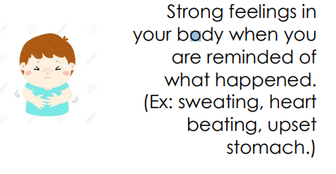
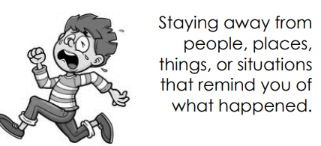
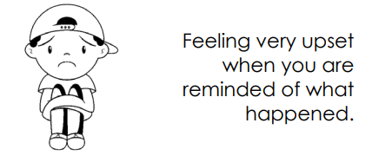
Notes:
PTSD symptoms – Could use to sort at ones they have or simply to name them

Slide 8
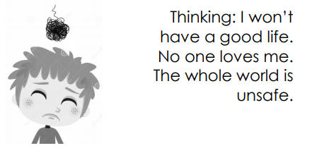
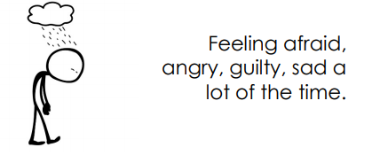
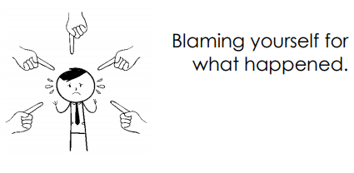
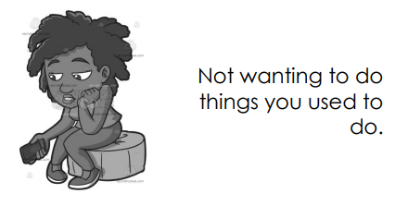
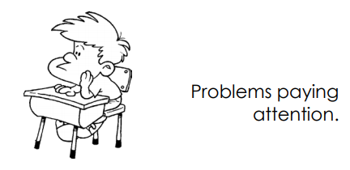
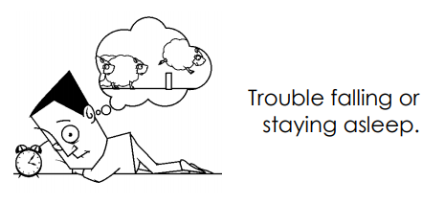

Slide 9
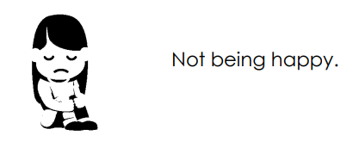
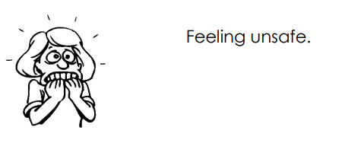

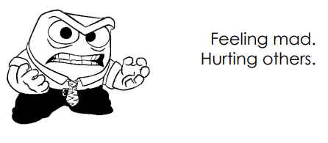

Slide 10
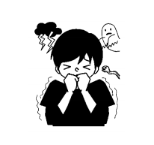
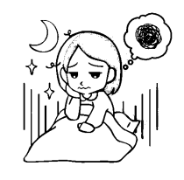

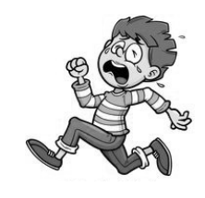

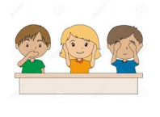
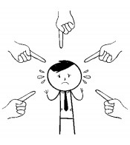
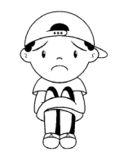






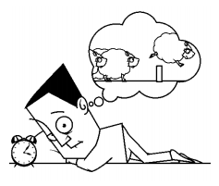

Notes:
PTSD symptom pictorially without words; Can use throughout other components to include trauma focus (ex: asking feelings when remember trauma)

Slide 11
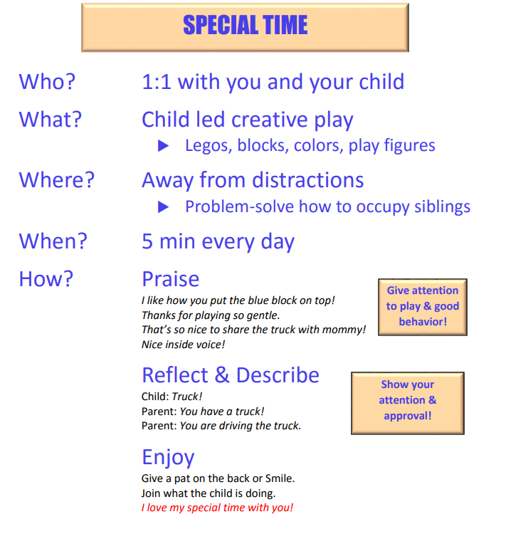

Slide 12
 | Monday | Tuesday | Wednesday | Thursday | Friday | Saturday | Sunday
Get Dressed
Breakfast bowl in Sink
Quiet Book Time in Room
Put blocks in toybox
Belly Breaths Practice
Put on PJs
Notes:
Example of PreK “Important Things To Do Today!”
Plan with parent specific tasks; Only use positive attention and rewards; Earning stickers for immediate reward/praise
5-7yr olds can also build in end of day reward for getting a certain number of stickers

Slide 13
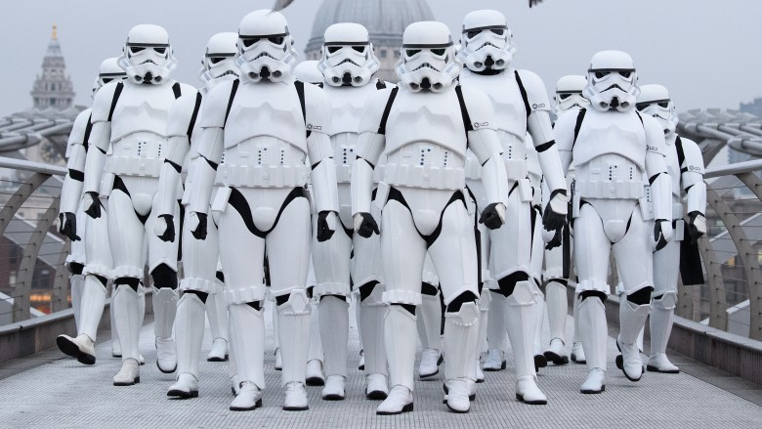

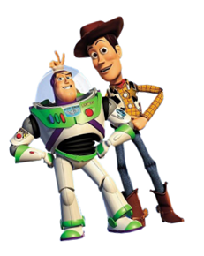
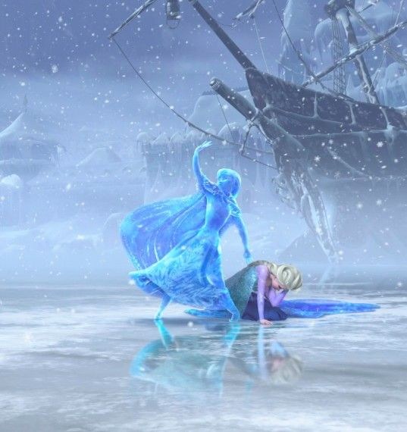
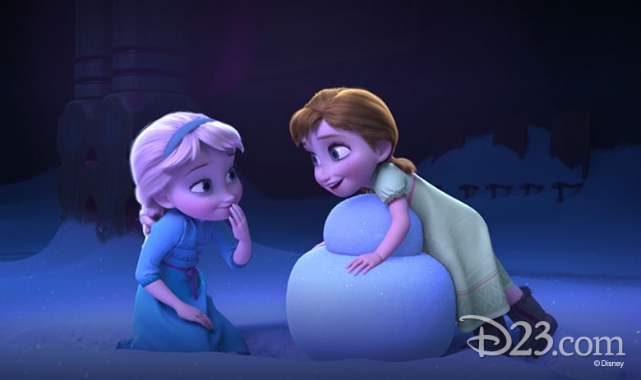
Be Chill like Chewy!
Notes:
Use child’s interest to create images to pair with full body PMR. Ex: stiff tight muscles like storm troopers; buzz lightyear; frozen Anna; Warm, loose relaxed muscles like Chewbacca, Woody, Melted Anna

Slide 14
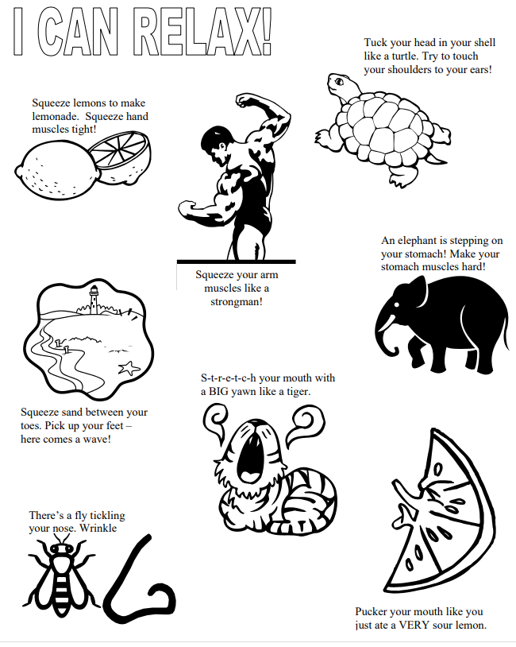

Slide 15
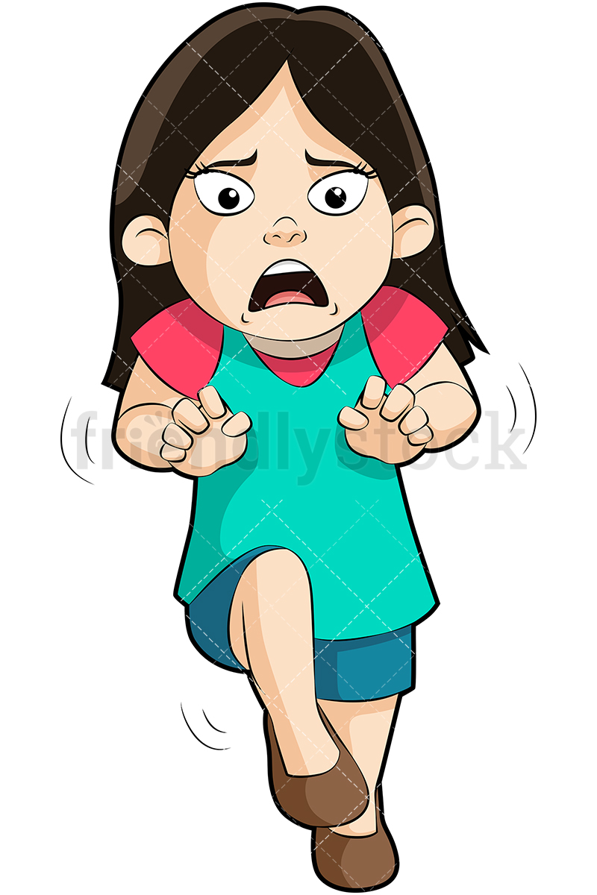
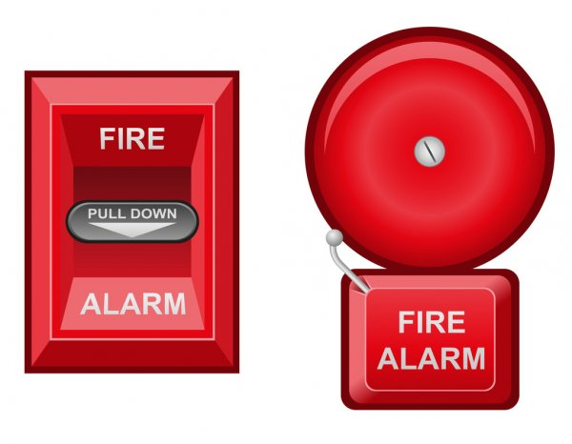
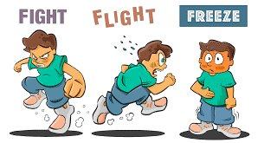
Notes:
Fire Alarm Analogy; Fight Flight Freeze;

Slide 16
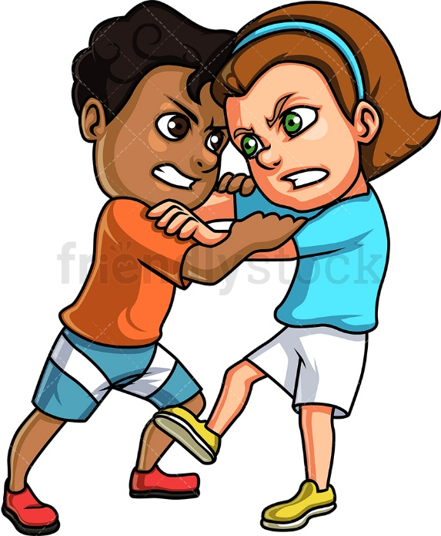


Notes:
More fight flight freeze;

Slide 17

Notes:
Learning Feelings Words: Let child pick color to uncover a feeling; Show pictures and have child name the feeling; Teach one the child doesn’t know; Have child show on their face what the feeling looks like; Therapist makes a feeling face and child points to which feeling and says name of feeling;

Slide 18




Notes:
How would a kid feel when: Thunderstorm; get candy; brother take toy; fall off bike; dinner is yucky
Have child tell a time that they feel: angry, sad, scared, disgust(grossed out); happy

Slide 20

Feelings Gauge
How strong is your feeling?
Middle
Little
3
7
A Lot
1
10

Slide 21



Think
Do
Feel

Slide 22


Notes:
Head heart hands for teaching cognitive triangle.

Slide 23







Notes:
Use these or any other visuals to cue trauma narration for young kids

Slide 24


Slide 25
Links to Videos, Resources to Use in Therapy
Resource | Component | Web location
Brain Builders | Psychoeducation | https://www.youtube.com/watch?v=23jDxNOdDCk
Rosie Remembers - Grief | Psychoeducation | https://www.nctsn.org/resources/rosie-remembers-mommy-forever-her-heart
Belly Breath - Sesame Street | Relaxation | https://www.youtube.com/watch?v=_mZbzDOpylA
Daniel Tiger - Relaxation Song | Relaxation | https://oeta.pbslearningmedia.org/resource/ce65aeaa-ddd2-45dd-908e-6abd84ef2cb2/ce65aeaa-ddd2-45dd-908e-6abd84ef2cb2/
Daniel tiger - social emo songs | Affect | https://open.spotify.com/artist/0T91UD2v3byVXh8aSP8oHG?si=5Yuiqy1yRJS1pZd9OHKxGA
Inside Out Feeling Guessing Game | Affect | https://www.youtube.com/watch?v=dOkyKyVFnSs
Inside Out - Feelings Validation Video | Affect | https://www.youtube.com/watch?v=1Evwgu369Jw
I’m Happy – Sad Digital Book | Affect | https://www.freespirit.com/files/original/Im-Happy-Sad-Today-preview-1.pdf
Brene Brown - empathy | Affect | https://www.youtube.com/watch?v=QT6FdhKriB8
Kung Fu Panda - Let it Flow | Trauma Narration | https://www.youtube.com/watch?v=RqjIkkwMlnw
Problem Sexual Behavior Info | Enhancing Safety | www.ncsby.org
My body Belongs to me | Enhancing Safety | https://www.youtube.com/watch?v=a-5mdt9YN6I

