Slide 1
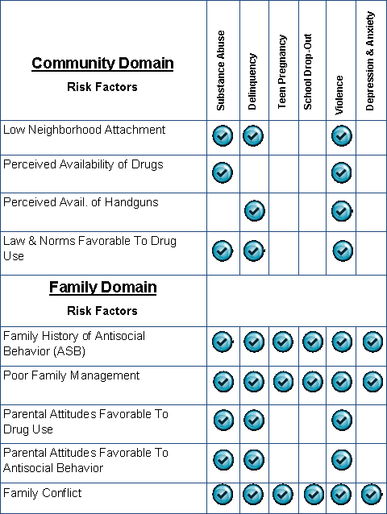
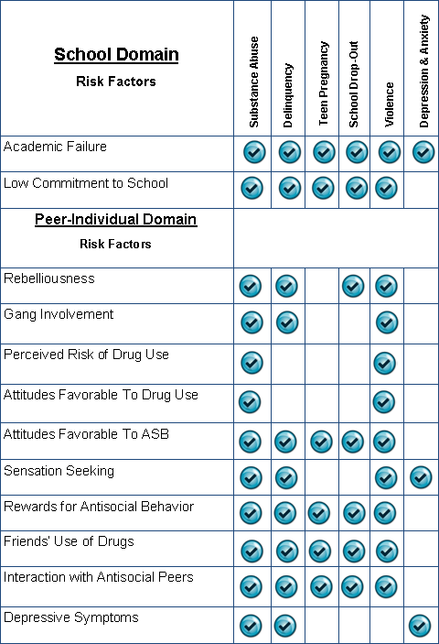
PA Youth Survey (PAYS)
Risk Factors & Related Problem Behaviors (21 RFs in Total)

Slide 2
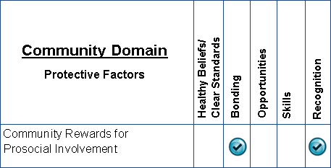
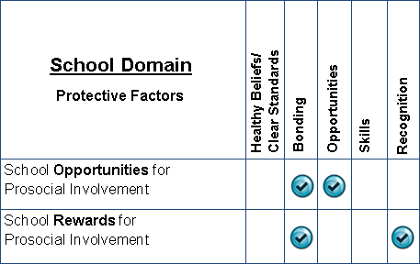
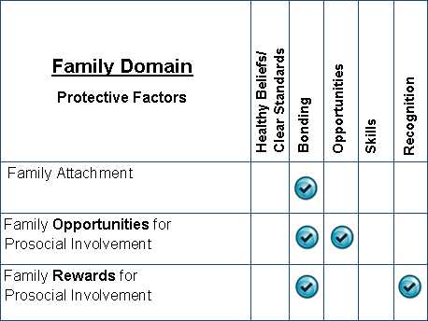
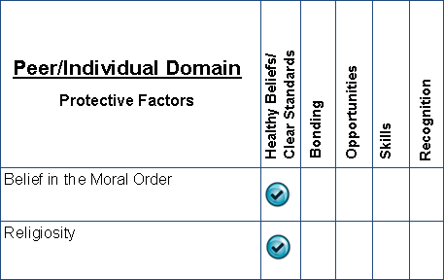
PA Youth Survey (PAYS)
Protective Factors & Related Social Development Components (8 PFs in Total)

