Slide 1
2019 PAYS Overview
Just the Basics

Slide 2
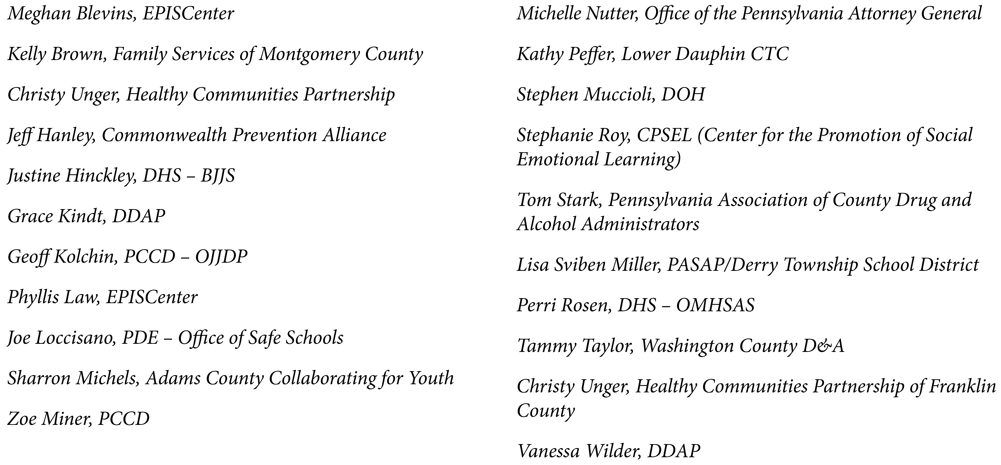
THANK YOU
PAYS Advisory Group (PAYSAG)
2

Slide 3
Participation By-The-Numbers
3
Notes:
GK

Slide 4


2019 was the
15th
bi-annual
voluntary survey conducted since 1989
YES!
Pennsylvania is celebrating
30 YEARS
of using student survey data to drive decision-making!
4
This Photo by Unknown Author is licensed under CC BY-SA
Notes:
GK

Slide 5
Administration/Participation History
1989 – 1997
Participation ranged from approximately 38,000 to 81,000 students
Participants identified through random sampling
Grades: 6, 7, 9, 12
Instrument: Primary Prevention Awareness, Attitude, & Usage Scales (PPAAUS)
2001 – 2019
Participation ranged from approx. 89K to 280K students in 150 to 413 school districts
Participants identified through probability proportional to enrollment
Grades: 6, 8, 10, 12
Instrument: Communities That Care Youth Survey = PA Youth Survey (PAYS)
5
Notes:
GK

Slide 6
Administration Overview
 | 2015 | 2017 | 2019
# of School Districts | 356 | 379 (76% of Total) | 413 (83% of Total)
# of Traditional Schools | 960 | 973 (58% of Total) | 1135 (60% of Total)
# of Non-Traditional Schools | 37 | 39 | 60
# of County Reports (9 counties with 1 school district = no county report) | 54 | 55 | 56
# of Counties with no PAYS data (2015: Sullivan, Union, Wayne, Wyoming) (2017: Montour, Sullivan & Wyoming) (2019: Wyoming) | 4 | 3 | 1
6
Notes:
GK

Slide 7
Percent of Students Enrolled in Participating Schools
26,379
41,387
74.2%
Participation Rate of Participating Schools
7
Notes:
GK

Slide 8
Percent of Participating Students Enrolled in
All Eligible Schools Statewide
26,379
12,327
54.2%
Participation Rate of All Eligible Schools
8
Notes:
GK

Slide 9

Validity Checks
 | 2015 | 2017 | 2019
Surveys Administered | 230K | 258K | 288K
# of Invalid Surveys | 13K | 4K | 7K
% of Surveys Removed | 6% | 1.9% | 2.3%
Any # < 10%
considered statistically valid
Used fictitious drug (3,497)
Improbably high levels of drug use (2,524)
Past-month rates higher than lifetime rates (1,654)
Age-grade inconsistency (1,622)
Age of joining a gang higher that was higher than age (468)
Many surveys met multiple dishonest and/or exaggeration checks
9
Notes:
GK

Slide 10
Survey & Report Basics

Slide 11
Topics & Edits Added
Over Time
NEW!
Restorative Rest/Daytime Sleepiness
Depression & Substance Use
Bullying & Depression/Suicide
Illegal Prescription Drug Use
Vaping/e-Cigarette Use
Gambling
Depression and Suicidal Ideation
Violence on School Property
Bullying Online and Internet Safety
Physical and online Abuse
Transitions and Mobility
After-school Activity Involvement
Sources of Alcohol & Rx Drugs
Reasons for Being Bullied
Self-Harm
Updated Spanish translation versions
11

Slide 12
PAYS Local/County Report Sections
Demographics
ATOD Use and Access
  High Prevalence/Early Initiation
  Rx & OTT Drugs & Medications
  Other Drugs
  Risky Substance-Use Behaviors
  Access & Willingness to Use
Antisocial Behavior
  Gambling
  Other Anti-Social Behavior
Community & School Climate & Safety
  Commitment to School
  Involvement in Pro-Social Activities
  Violence/Drugs on School Property
  Bullying & Internet Safety
Social & Emotional Health
  Mental Health Concerns & Suicide Risk
  Transitions & Mobility, Grief, & Other Stressful Events
  Cross-Tab Analysis:
    Depression & Substance Use (page 62)
    Bullying & Depression/Suicide (page 63)
  Sleep (page 67)
Systemic Factors
  Perception of Risk
  Perception of Parental Disapproval
  Perception of Peer Disapproval
  Attitudes Toward Peer Use
  Community Risk Associated with Availability
  Rules & Antisocial Behavior
  Favorable Attitudes Toward Drug Use
Risk & Protective Factors
  Risk & Protective Scales Defined
  Understanding Cut-Points
  Overall Risk & Protective Scores
  Risk & Protective Factors by Grade
12

Slide 13
2019 Sleep Questions
Restorative Rest Question Added:
  On an average school night, how many hours of sleep do you get?
    4 or less hours
    5 hours
    6 hours
    7 hours
    8 hours
    9 hours
    10+ hours
Daytime Sleepiness Question Added:
  In the last two weeks, how often have you felt tired or sleepy during the day?
    Everyday
    Several Times
    Twice
    Once
    Never
13

Slide 14
Where To Go For
Information & Assistance
14

Slide 15
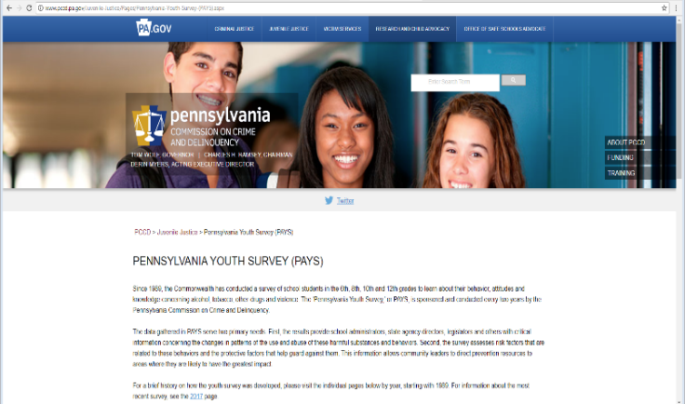
PCCD
www.PAYS.pa.gov
15
Notes:
GK

Slide 16

Two PAYS
State Reports
Methodology & Deeper Dive
Trend Profile Report
Coming in June!
16
Notes:
Geoff

Slide 17
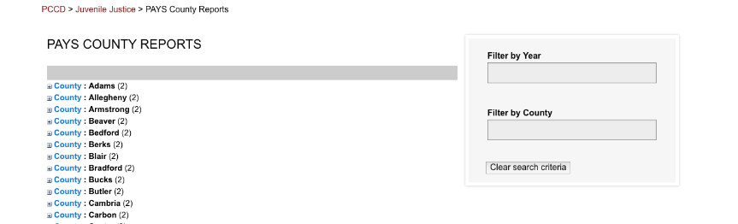
Access to County Reports
17
Notes:
GK

Slide 18
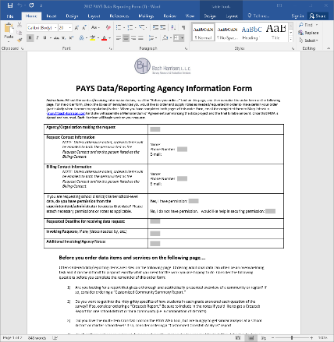
Special Report Order Form
18
Notes:
GK

Slide 19
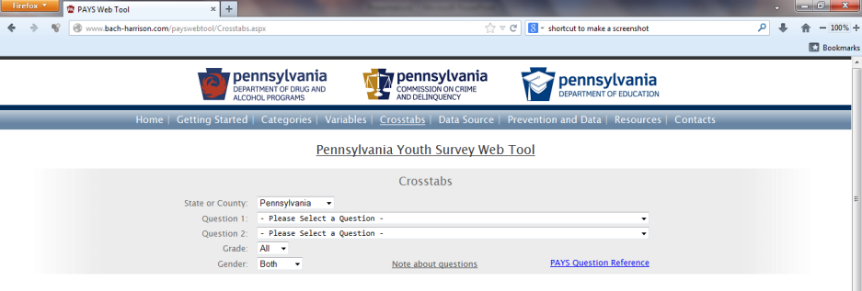
Data “Crosstabs” Tool
Use the “Crosstab” Tool if:
  You’re interested in really diving into your data
  Ideal for grant writing and reporting – when you have a need to tell an engaging data story
  Considered to be a more advanced tool. Caution: It is quite easy to misinterpret or misrepresent this data
Five simple steps to create charts & tables:
Select “state” data or a county
Select your primary question
Select your secondary question (the contextual variable)
Select the grade population
Select the gender population
NOTE: Strongly recommend use of supplemental documents on this tool/page.
19
Notes:
GK

Slide 20

www.EPISCenter.psu.edu
Visit www.episcenter.psu.edu
Click the PA Youth Survey tab
Select Submit a Question
Your question will go directly to EPIS Staff!
20
Notes:
PL

